Slide 1







SECURE BOOTSTRAPPING FOR ARM MCUs
Material prepared by Bálint Bujtor , Juan José Restrepo, Jovan Žunić and revised by Stefano Di Carlo, Alessandro Savino, Alessio Carpegna and Cristiano Chenet
This work is licensed under the Creative Commons Attribution-NonCommercial 4.0 International License. To view a copy of this license, visit
http://creativecommons.org/licenses/by-nc/4.0/.

Slide 2

But what is bootstrapping?
Bootstrapping: usually refers to a self-starting process that is supposed to continue or grow without external input.
Where does it come from?
Boot may have a tab, loop or handle at the top known as a bootstrap, allowing one to use fingers to help pulling the boots on.
Dates to 1850s: "to pull oneself up by one's bootstraps" - an impossible task
Figure taken from: https://en.wikipedia.org/wiki/Bootstrapping

Slide 3
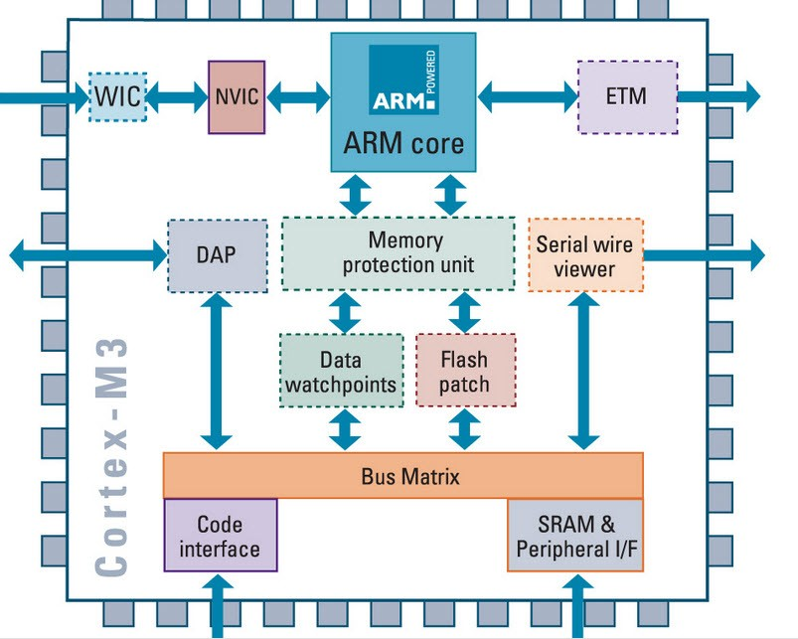
Booting process in ARM based MCU
Power on Reset (Hardware Process)
Memory Aliasing (Remapping) and Architecture (Hardware Process)
Firmware Booting (Hardware and Firmware Process)
Reset_Handler() execution, for bringing up firmware (Firmware Process)
Figure taken from: https://hothardware.com/news/arms-cortexm3-cpu-used-in-embers-zigbee-chips

Slide 4
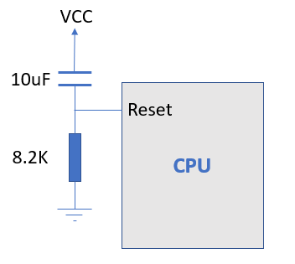
Power on Reset
Responsible for generating resetting signals whenever power is supplied to a given electrical device.
Predefined checks in the hardware to bring the MCU up.
Figure taken from: https://hothardware.com/news/arms-cortexm3-cpu-used-in-embers-zigbee-chips

Slide 5
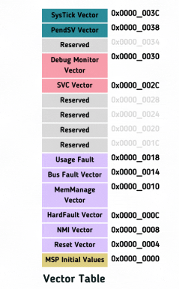
Memory Aliasing (Remapping) and Architecture
The processor starts pointing from the 0x0000_0000 address.
This zero address can also be remapped to any other address in the address space with the help of Remapper.
This results in booting/execution from different address spaces or different applications.
Figure taken from: https://embeddedwala.com/Blogs/embeddedsystem/bootsequenceofarmbasedmcu

Slide 6
Firmware booting
After the Memory Aliasing stage, where the processor takes the boot mode selection pin configuration and is ready to fetch the instruction from the target address, firmware booting starts.
Firmware boot starts with the fetch of a WORD to the Program counter (PC). The program counter (PC) is loaded with the address 0x0000_0000 value.
PC after 0x0000_0000 points to the next instruction which is 0x0000_0004

Slide 7
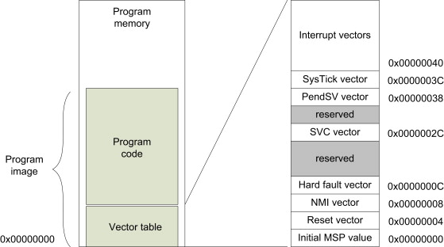
Reset handler
Reset Handler in ARM based MCU is considered as an entry point of the firmware.
This value of the reset handler in the vector table is basically a pointer to the actual function
Figure taken from: http://www.sunyouqun.com/2017/05/mcu-startup-procedure/

Slide 8



OK…but…possible attacks!!
Figure taken from: https://www.mobileworldlive.com/spanish/suecia-advierte-de-la-amenaza-rusa-contra-las-telecomunicaciones/
Figure taken from: https://www.ikusi.com/mx/blog/que-es-malware/
Mention the four stages of the booting process!
Figure taken from: https://www.amazon.com.mx/Se%C3%B1al-octogonal-texto-ingl%C3%A9s-Stop/dp/B07NDQXY86

Slide 9

Therefore…we need security
Two approaches
Secure boot
Trusted boot
Relies on certificates authorities
Identifies software components from hash values
Root of Trust(RoT)
Chain of Trust(CoT)
Figure taken from: https://www.redseguridad.com/actualidad/los-empleados-responsables-de-que-seis-de-cada-diez-empresas-sufran-ataques_20200908.html

Slide 10
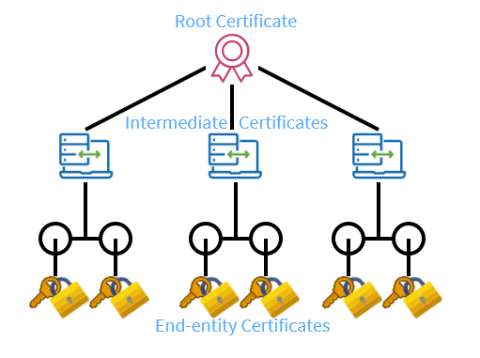
Trusted boot
Boot sequence includes the CoT, which is a constant passing of trust.
CoT: measures whether a piece of software can be trusted to pass the control of the system. It is broken down into chains.
RoT : verifies the first piece of code.
Figure taken from: https://www.keyfactor.com/blog/certificate-chain-of-trust/

Slide 11
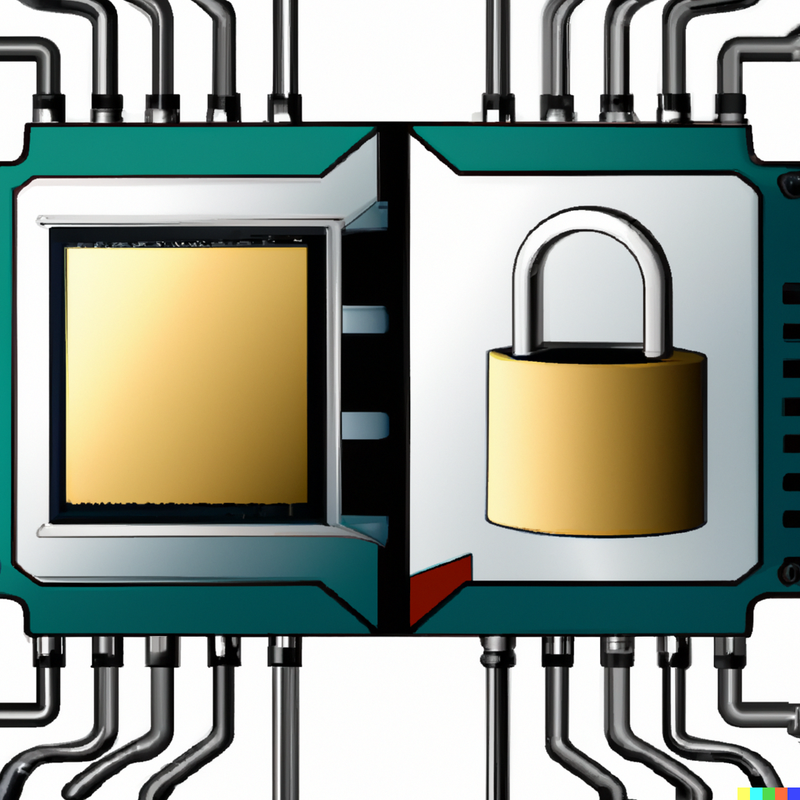
Trust Zone/TEE
Separates processor into two virtual processors, secure world and non-secure world.
Supports boot process, as one of the first stages of chains of trust to verify that code can be trusted.
Secure boot loads 1st stage trusted bootloader code to trusted zone, which then verifies and continues to next stage of secure boot process.

Slide 12
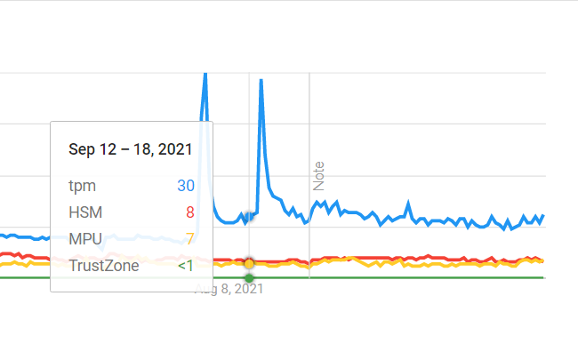
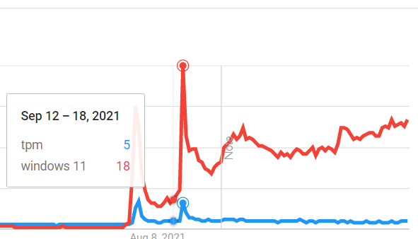
Secure hardware
HSM(Hardware security module) – stores keys and performs cryptographic operations
MPU(Memory protection unit) – Defines permissions to accessing memory regions
Trust Zone/TEE
TPM(Trusted platform module)
Secure ROM – verifies digital signature
Made using: https://trends.google.com/trends/?geo=IT

Slide 13
Additional hardware that can assist secure boot
Watchdog timer
Interrupt controller
Random number generator (RNG)
Power-on self-test (POST)
Tamper detection

Slide 14
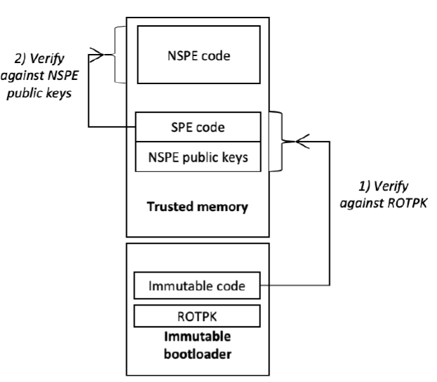
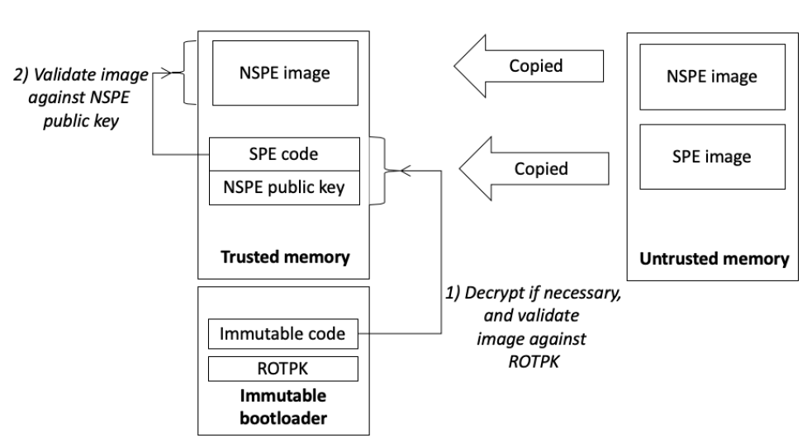
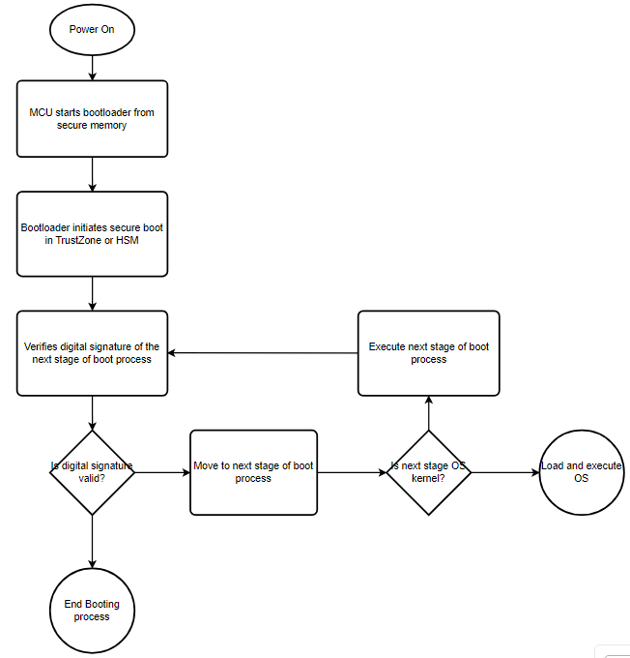
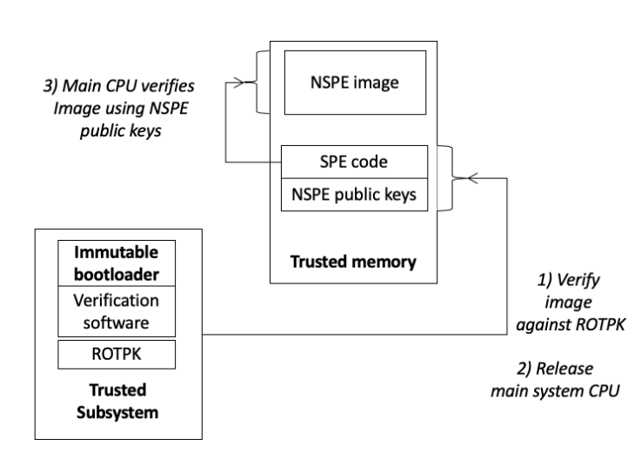
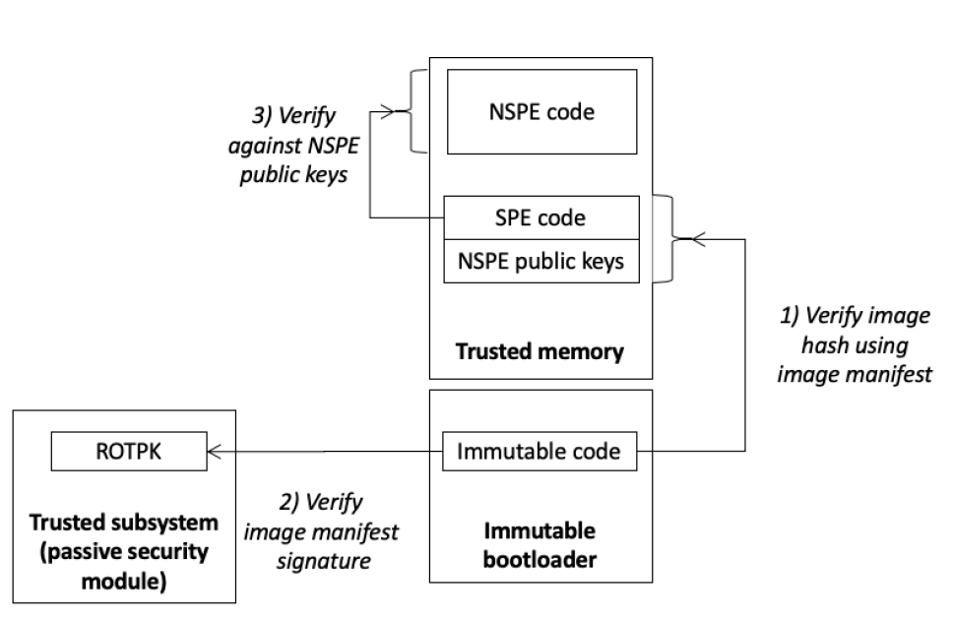
How it is done in real HW
Secure boot flow
Boot from on-chip storage
Boot from off-chip storage
Boot using a passive security module
Boot using a security processor
Figure 2
Figure 1
Figure 3
Figure 4
Figures 1, 2, 3 and 4 taken from: https://developer.arm.com/-/media/Arm%20Developer%20Community/PDF/PSA/DEN0072-PSA_TBFU_1.1-BETA0.pdf?revision=3ce2513a-ae0f-4b43-96a0-851ed67a640b

Slide 15
The boot is done - now what?
Protect the boot code
Code signing: the process of digitally signing executables and scripts to confirm the SW author and guarantee that the code has not been altered or corrupted
How?
Use a cryptographic hash and encryption to validate authenticity and integrity
Other methods?

Slide 16
Cryptography: fundamentals
The goals of cryptography:
Confidentiality: protection of sensitive data against unauthorized accesses
Authentication: guarantee of the information identity
Integrity: detection of any information corruption
Cryptographic hash: a mathematical algorithm that maps data of arbitrary sizes to a digest of a fixed bit size (known as a “hash” or “hash digest”).
Hash algorithms can be classified into two categories:
Those that work on a variable length of bits
SHA1, SHA2...
Those that work on a fixed length of bits, also called a Block Cypher
AES

Slide 17
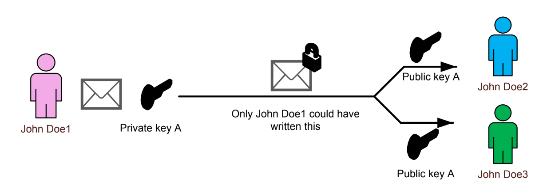
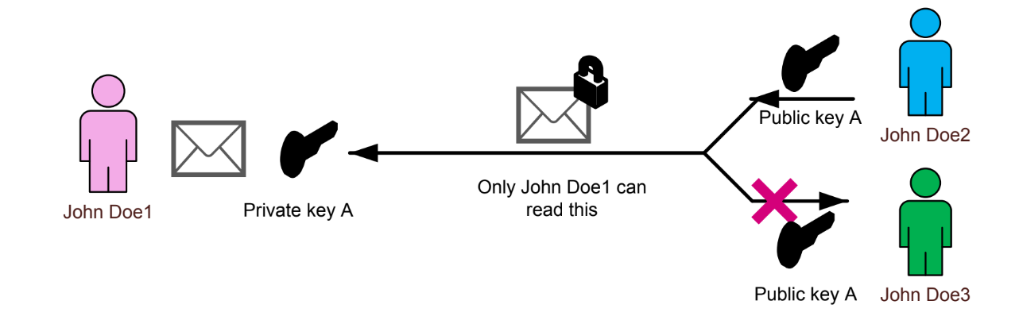
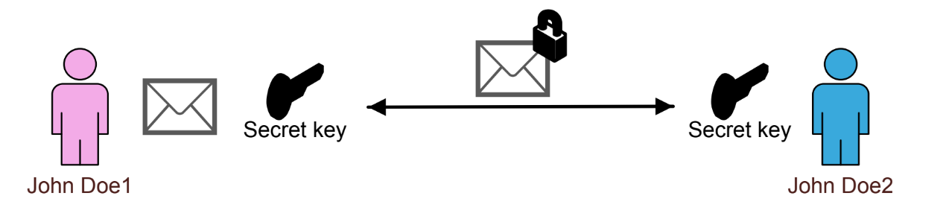
Cryptography: What to do with the hash?
Use the hash algorithm and a type of encryption to secure your boot code
Asymmetric cryptography: there is a private and a public key pair
Public key: used to decrypt the information. It can be shared
Private key: used to encrypt the information. It must be kept secret
This way only the sender can know the original source
Symmetric cryptography: the same key is used to encrypt and to decrypt the code
The key must be kept secret
Figures taken from: https://www.st.com/resource/en/application_note/an5447-overview-of-secure-boot-and-secure-firmware-update-solution-on-arm-trustzone-stm32-microcontrollers-stmicroelectronics.pdf

Slide 18
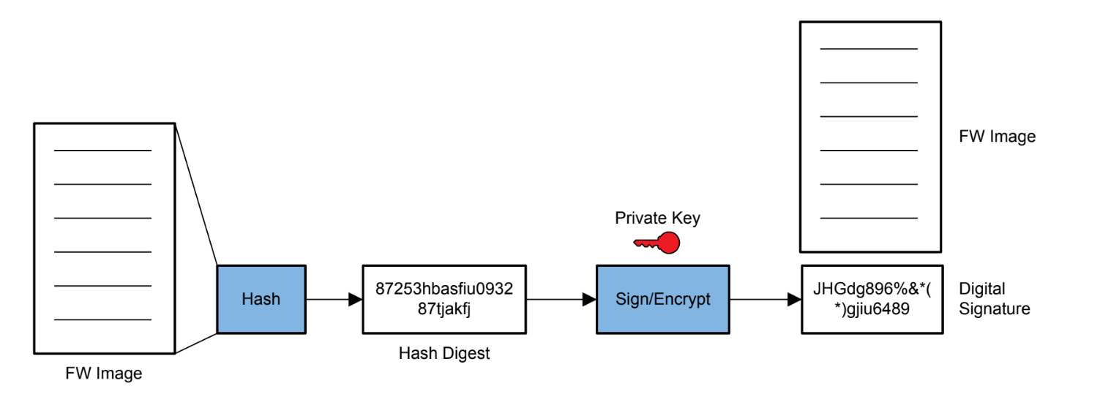
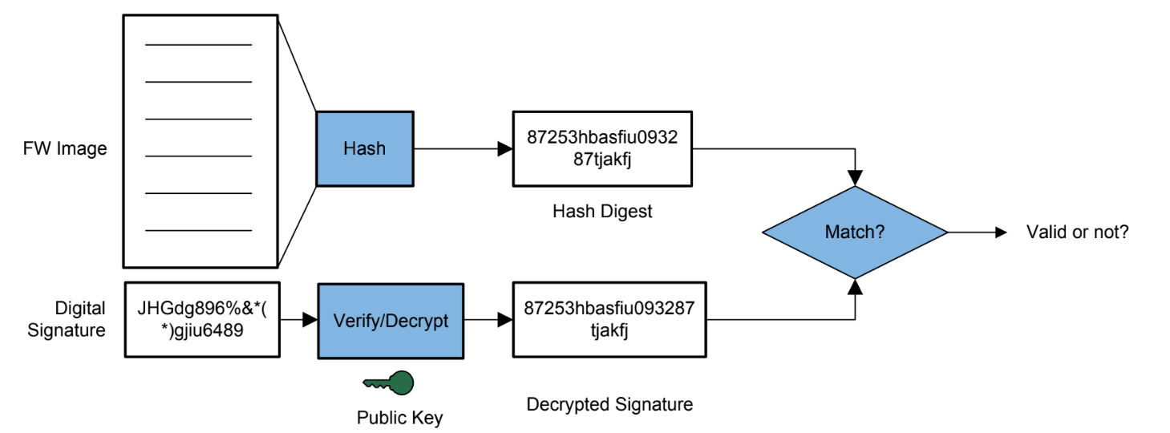
Cryptography: in practice
During development
Finalize your boot code
Create your hash digest from it, with your hash algorithm
Sign/encrypt it with your private key
Store the digital signature securely on your HW
During use
Create your hash digest from your current boot code
Decrypt the digital signature with your public key to get the original hash digest
Compare the two
If they match, no problem
Otherwise, it might be corrupted or attacked
Figures taken from: https://www.ti.com/lit/an/swra651/swra651.pdf?ts=1677154880657&ref_url=https%253A%252F%252Fwww.google.com%252F

Slide 19
Other methods?
for(i = 0; i < N; i++)
starttime = timestamp();
runBootSequence();
endtime = timestamp();
bootTime[i] = starttime – endtime;
for (i = 0; I < N; i++)
Sum = bootTime[i]
averageBootTime = Sum / N;
std_dev = sqrt(Σ(bootTime[i] - averageBootTime)^2 / N )
------------------
In use:
if((CurrentBooTime > averageBootTime-std_dev) && (currentBootTime < averageBootTime+std_dev)
){
start_OS()
}
The previously mentioned techniques are time and resource consuming, thus expensive
Alternative approach: measure and average boot time and try to filter attacks and corruptions based on a precalculated "golden" time
Using the performance counters (or system tick timer or general timer) on the microcontroller

Slide 20



Attacks on secure boot
Attacks can be done depending on:
Weak hardware
Weak software
Weak design/implementation
In some industries tampering can cause injuries, and have serious consequences, like in automotive ECU and industrial controls.
Figure taken from: https://pixabay.com/illustrations/payment-terminal-credit-card-receipt-6400952/
POS terminals can be skimmed to steal your credit card information
Photo: Fabian Albert/Unsplash
Photo: James Lewis/Unsplash

Slide 21
Attacks on secure boot
Bootkit attacks
Firmware attacks
Replay attacks
Side-channel attacks
Key extraction attacks
Debugging access (JTAG/UART)
Overriding boot source
Timing attacks
Design mistakes
Accessibility of boot ROM after boot
Key management
Weak signing keys/methods
Some famous examples: Iphones, PS3, XBOX, Nokia etc.1

Slide 22
References
Secure Boot in SimpleLinkTM CC13x2/CC26x2 Wireless MCUs
Introduction to STM32 microcontrollers security
S. Zimmo, A. Refaey and A. Shami, "Trusted Boot for Embedded Systems Using Hypothesis Testing Benchmark," 2020 IEEE Canadian Conference on Electrical and Computer Engineering (CCECE), London, ON, Canada, 2020, pp. 1-2, doi: 10.1109/CCECE47787.2020.9255703.
Overview of Secure Boot and Secure Firmware Update solution on Arm TrustZone STM32 microcontrollers. STMicroelectronics.
Ltd., A. (n.d.). TrustZone for cortex-m – arm®. Arm | The Architecture for the Digital World. Retrieved February 21, 2023, from https://www.arm.com/technologies/trustzone-for-cortex-m
Arm Platform Security Architecture Trusted Boot and Firmware Update 1.0. Arm https://developer.arm.com/-/media/Arm%20Developer%20Community/PDF/PSA/DEN0072-PSA_TBFU_1.1-BETA0.pdf?revision=3ce2513a-ae0f-4b43-96a0-851ed67a640b

